Slide 1
COMP 249 – Winter 2014
Tutorial 4: Exception Handling

Slide 2
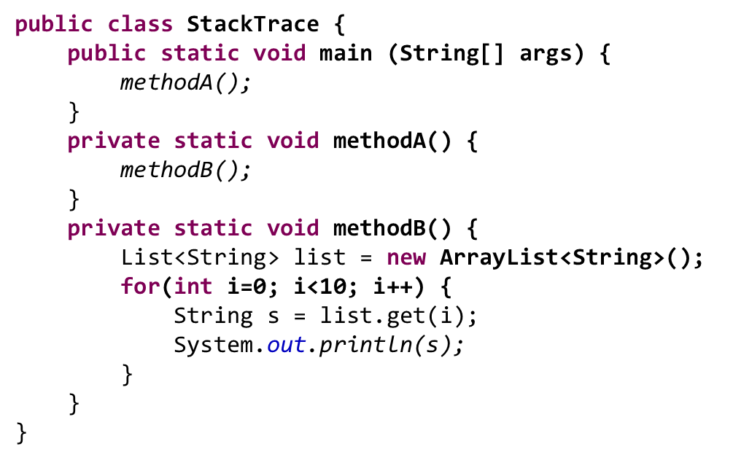
Problem 1
What would be the output of the following code?

Slide 3
Problem 2
What would be the output of the following code?
public class MultipleExceptions {
public static void main (String[] args) {
String input = "0";
int value;
try {
value = Integer.parseInt(input);
int result = 100/value;
System.out.println("Result ="+result);
}
catch(NumberFormatException e) {
System.err.println("Input must be an integer");
}
catch(ArithmeticException e) {
System.err.println("Division by zero");
}
catch(Exception e) {
System.err.println("General exception");
}
}
}

Slide 4
Problem 3
What would be the output of the following code?
public class Foo
{
public static void main(String[] args)
{
try {
System.out.println( "Trying..." );
return;
}
catch(Exception e) {
System.err.println("Catching exception");
}
finally {
System.out.println( "Finally !!!" );
}
}
}

Slide 5
Problem 4
Will the following compile? If so, what would be the output?
public class RTExcept
{
public static void throwit ()
{
System.out.print("throwit ");
throw new RuntimeException();
}
public static void main(String [] args)
{
try {
System.out.print("hello ");
throwit();
}
catch (Exception re ) {
System.out.print("caught ");
}
finally {
System.out.print("finally ");
}
System.out.println("after ");
}
}

Slide 6
Problem 5
Create a class Library with the properties
accountID
holderName
numberOfBooksBorrowed
maxNumberOfBooksAllowed
and a method to borrow books.
The borrow method should take as argument the number of books to be borrowed and throw an Exception if the user wants to borrow more than the maxNumberOfBooksAllowed.

Slide 7
Problem 6
Create your own Exception class called BorrowException and make the borrow method in Problem 5 throw this exception when the total number of books to borrow is more than numberOfBooksBorrowed.

Slide 8
Problem 7
Now, create a class CLUES with a main method which opens a Library account with maxNumberOfBooksAllowed as 5. try to borrow 10 books and catch the BorrowException if it occurs and send a user friendly message in any case.

